Slide 1
Unsupervised Learning
WKSP 320 Module 1, Lesson 3
Notes:
Welcome to the lecture on Unsupervised Learning. This is going to be fundamentally different from what we’ve learned so far. In the past, we’ve done exercises with known labels such as classification and estimation. In unsupervised learning, you don’t get that target information.

Slide 2
Unlabeled Data
Unknown underlying grouping
Normal vs abnormal network traffic
User Preference
Requires domain expert to verify groupings
Notes:
If you have unlabeled data and want to see if there are underlying groupings of the data, then you can use unsupervised learning as an initial step to help understand certain observations behave like some and not like others.
For example:
You may have a large pool of network traffic over multiple days and you want to detect if there was an attack during certain observations.
In this case, you don’t know beforehand what normal and abnormal traffic looks like
You can use unsupervised learning methods to try to group observations and see if an abnormal group presents itself
User preference:
If you have a product that you’re testing with users, such as operational users, you may not know ahead of time what their behavior would look like if they like or don’t like your product. By capturing how they are interacting with your product, you may see trends
For all of these, usually you can make a best guess as the groupings, but you won’t know the true number of groups in your data
Engaging with your domain expert can help determine the number of groups
A cyber SME might help you determine if the abnormal traffic group is represent attacks or some other event
Interviewing the customers or the User Design team would tell you if the groupings are indicative of customers who like/don’t like your product

Slide 3
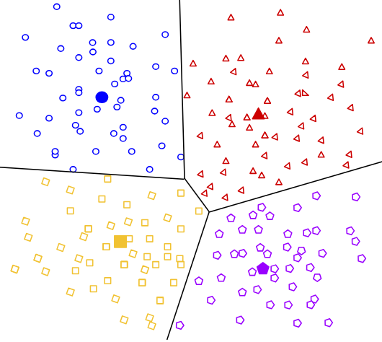
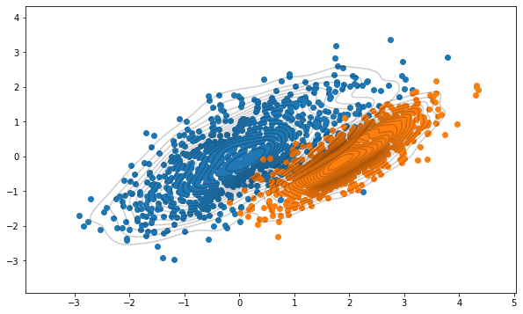
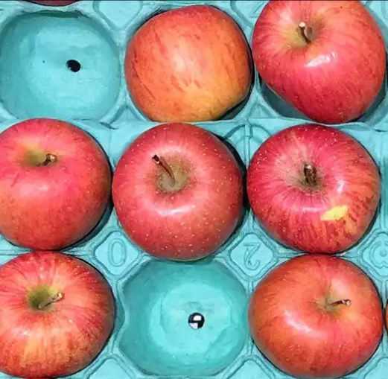
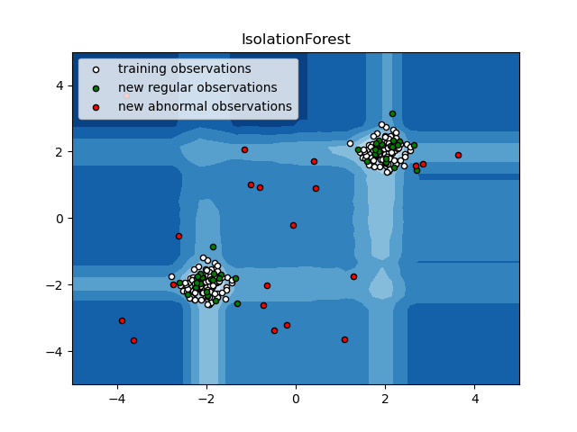
Unsupervised Learning Algorithms
Centroid Based Clustering
Gaussian Mixture Models
Anomaly Detection
Isolation Forest
Notes:
There are various unsupervised learning algorithms. You can group them in to 2 main groups – anomaly detection and clustering.
K-Means is a clustering algorithm where we estimate a centroid around a group and then assign members to the closest centroid.
Gaussian Mixture Models assume an underlying Gaussian distribution and then try to estimate mean and variance and number of distributions
Anomaly detection can be as simple as subtraction and averaging. Finding the average value for a variable and then identifying outliers.
Isolation Forest is a type of ensemble learning that also tries to find outliers in the data.

Slide 4
K Means
Choose number of clusters k
While clusters are still moving:
Mean vector of points → centroid
Calculate distance to each centroid
Assign each data point to cluster with nearest centroid
Notes:
Of the different methods, K-Nearest Neighbors is probably the best known and easy to understand.
First choose the number of clusters you want to have. Often, you don’t know what that number should be because this is not labelled data.
You can make an educated guess, use the help of a domain expert, or we’ll see a method later on to use the Sum of Squared Error to make a good choice.
Randomly assign points to a particular cluster.

Slide 5
Cluster1
Cluster2

Slide 6
K Means
Choose number of clusters k
While clusters are still moving:
Mean vector of points → centroid
Calculate distance to each centroid
Assign each data point to cluster with nearest centroid
Notes:
You iterate this algorithm a number of times. As it iterates, the algorithm will switch which group the observations will be assigned to.
At first you’ll randomly assign points to a cluster.
You’ll take the mean values of all the points assigned to a cluster and that will give you the centroid.

Slide 7


$$(\overline{x_{1}},\overline{y_{1}})$$
2
1
$$(\overline{x_{2}},\overline{y_{2}})$$
Cluster1
Cluster2

Slide 8


$$(\overline{x_{1}},\overline{y_{1}})$$
$$(\overline{x_{2}},\overline{y_{2}})$$
Cluster1
Cluster2

Slide 9

K Means
$$d\left(p,q\right)=\sqrt{\sum_{i=1}^{n}{{\left(q_{i}−p_{i}\right)}^{2}}}$$
Choose number of clusters k
While clusters are still moving:
Mean vector of points → centroid
Calculate distance to each centroid
Assign each data point to cluster with nearest centroid
Notes:
There are a few different kinds of unsupervised learning algorithms. Most rely in clustering or finding clusters in the data.
K-Nearest Neighbors is probably the best known and easiest to understand.

Slide 10
farther
2
closer
1
Cluster1
Cluster2

Slide 11
2
closer
1
Cluster1
Cluster2

Slide 12
2
1
Cluster1
Cluster2

Slide 13
2
1
Cluster1
Cluster2

Slide 14
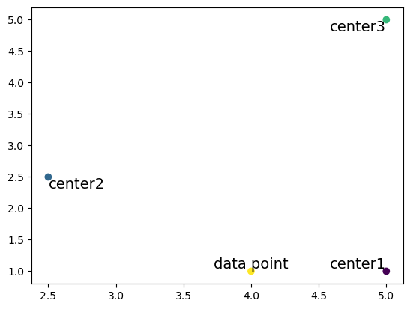

Distance Calculation Example
$$d\left(p,q\right)=\sqrt{\sum_{i=1}^{n}{{\left(q_{i}−p_{i}\right)}^{2}}}$$
d=4.12
d=2.12
d=1

Slide 15
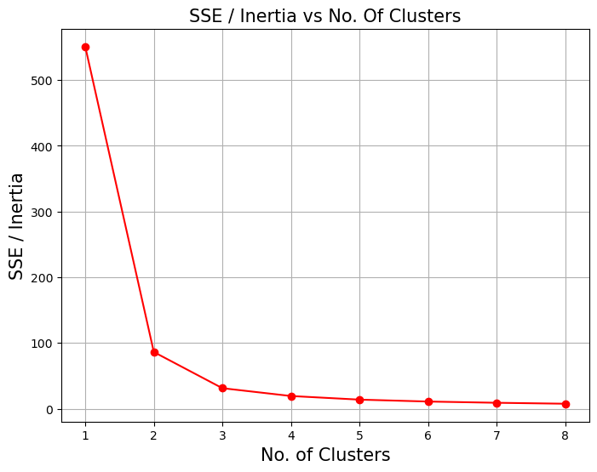

Choosing K with SSE
$$SSE\left(p,q\right)=\sum_{i=1}^{n}{{\left(q_{i}−p_{i}\right)}^{2}}$$
Elbow at K=3
Notes:
Choose a K value. Perform the K-Means algorithm with K clusters and run the algorithm till the centroids are stable.
Then compute the SSE from each centroid to each member of the cluster. Basically, find the square of the distance from each point to it’s centroid. Addd all those up and you get SSE.
If you plot the value of K to the overall SSE, there will be an elbow where SSE drops fastest and then starts to level off. That is a good value of K to choose.

Slide 16
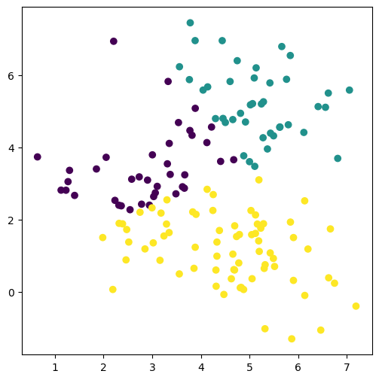
Iteration = 1
Notes:
This is a generated dataset of 3 blobs that slightly overlap. After 1 iteration we get this estimated clustering.

Slide 17
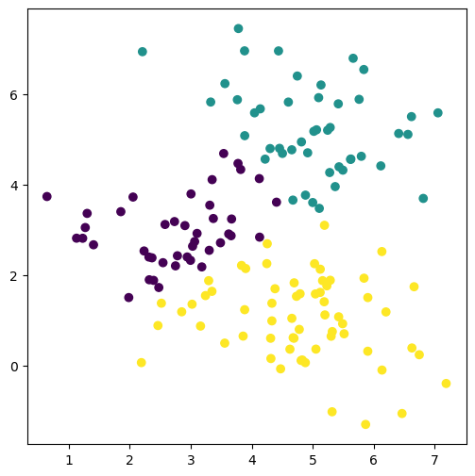
Iteration = 2
Notes:
There’s not much relabeling in the next few iterations but you see some movement. Most of the relabeling will happen around the boundaries of the clusters as the algorithm tries to determine where that boundary should be.

Slide 18
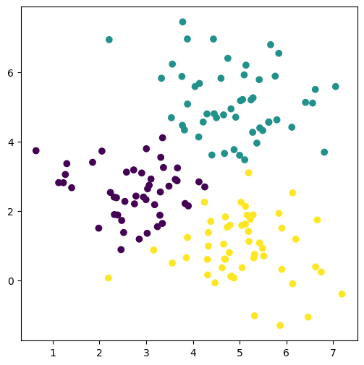
Iteration = 3

Slide 19
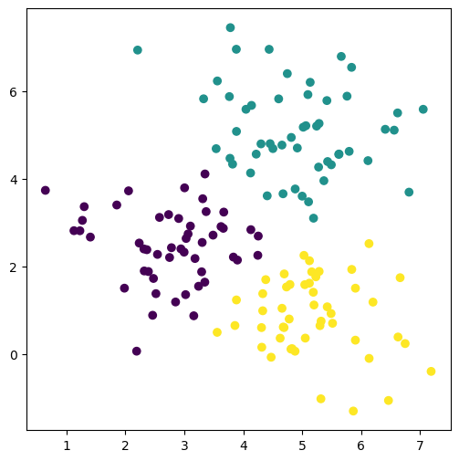
Iteration = 4

Slide 20
Iteration = 5
Notes:
By iteration 5, you see that there is no more change between the labels of each group. So we’re at a steady state after iteration 5.
So we’ll go ahead and learn how to use the K-means algorithm both on synthetic data and on the DPA dataset.

